Slide 1

Cochise Linux User group

Slide 2
How to make GRUB menu appear automatically at boot

Slide 3
How to make GRUB menu appear automatically at boot
Open a terminal
Type: sudoedit /etc/default/grub
Enter your requested password

Slide 4
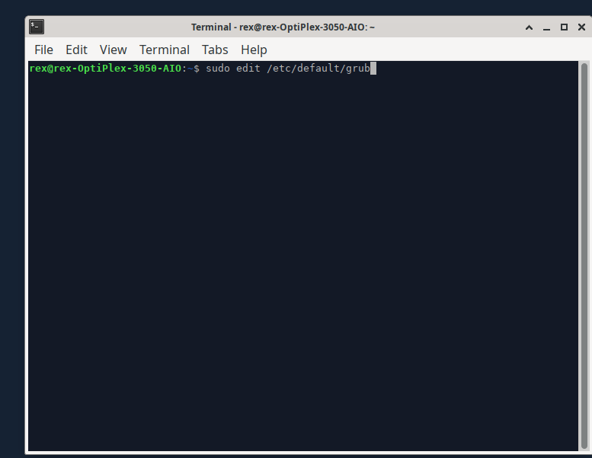
How to make GRUB menu appear automatically at boot

Slide 5
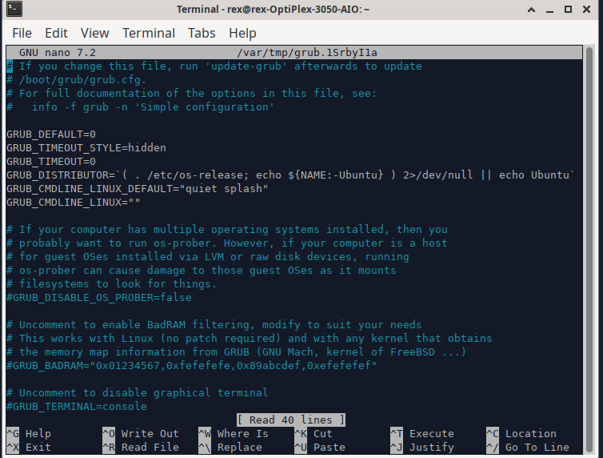
How to make GRUB menu appear automatically at boot

Slide 6
How to make GRUB menu appear automatically at boot
You are going to edit lines 2 and 3
In line 2, change hidden to menu
In line 3, change 0 to 2
Press Ctrl + x to exit
Finally press enter to exit Nano

Slide 7
How to make GRUB menu appear automatically at boot
You are back at the terminal so you now must enter: sudo update-grub
Reboot and you will see the GRUB menu for however many seconds you entered in line 3

Slide 8
Cochise Linux User group

